Slide 1
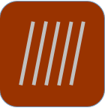
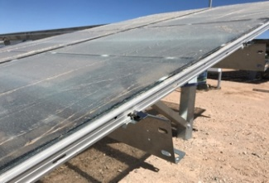
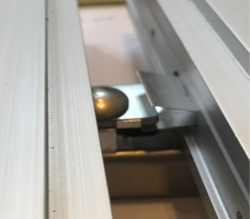
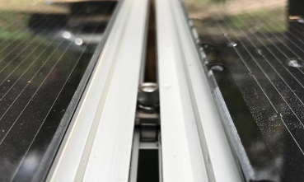
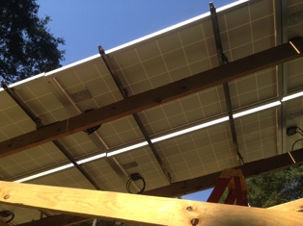
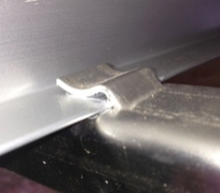
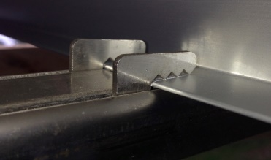
MODURACK, INC.
Company Profile
  Focus on making solar off-the-shelf system from engineering system
  Innovative solar clamping and racking for speed and easy installations
  Enable factory ready modular racking systems
  Enable machine installations
  Hybrid for both top and bottom fixing
Top Product Highlights
  Bull Clamp for First Solar S6 speed slot and 2-person installation
  Integrated Rack for silicon modules
  that support 1-person installation
Regional Coverage | Company Presence | MW Installed | Key Contact Information
Global | USA, China, Japan, Korea | 66 | Jian Yuan 408-888-7229
ModuRack Company Profile

Slide 2
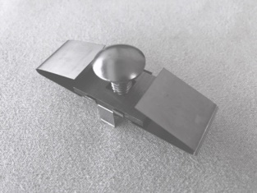
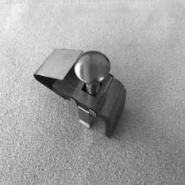
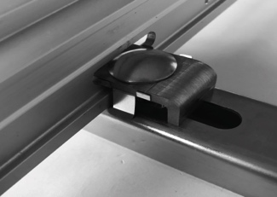
Bull Clamp For first solar S6 Modules
Key Features
  Snap-n-lock
  Build in module alignment
  Hybrid top and bottom mounting
  Fit for most rails
  Integrated bonding
  SUS300 materials
  Build in rail tolerance
Top Product Benefits
  Super fast and extra safety
  Enable machine installation
  Flexible for roof, carport and ground use
  No change on rails
  Eliminate bonding cost
  Good for any areas
  Easy on installers
Regional Coverage | Company Presence | MW Installed | Key Contact Information
Global | Support all countries | 66 | Jian Yuan 408-888-7229
ModuRack Company Profile

Slide 3
Packaging – bull clamp
Packaging for Bull Clamps
  24 kpcs per pallet: about 5 MW
  Pallet size 1100 x 1100 mm
  Gross Weight 1.05 ton, Volume 1.6 m³
  1 kpcs per cartoon box, 275 x 365 cm³
  100 pcs per bag
  One clip-release tool per pallet
Top Packing Highlights
  Easy on ordering and inventory control
  Fit both folk lift and manual handling
  Weather resist pallet protection
ModuRack Company Profile

Slide 4
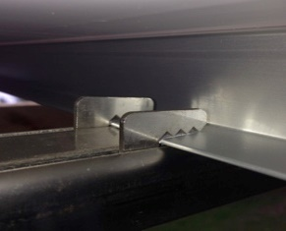
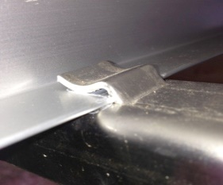
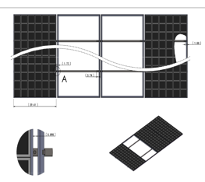
Integrated Rack For Si-modules
Key Features
  Snap-n-lock
  Same racks good for most silicon modules and any layout
  Stainless or galvanized steel
  Inside clamping good for various module height
  Hybrid top and bottom mounting
  Retaining clamps
Top Product Benefits
  Dramatically reduce installation time
  Dramatically reduce project cycle time
  Lower railing cost
  Least number of parts
  Same racks good for roof, carport or ground installation
  Fail-safe under severe weather
Regional Coverage | Company Presence | MW Installed | Key Contact Information
Global | Support all countries | 66 | Jian Yuan 408-888-7229
ModuRack Company Profile

Slide 5
Packaging – integrated rack
Packaging for Integrated Rack
  12 rails per bundle good for 24 modules
  144 rails per pallet good for 288 modules
  Volume: 0.4 x 0.4 x 4 m³
  Gross Weight 0.7 ton
Top Packing Highlights
  Easy on ordering and inventory control
  Fit both folk lift and manual handling
  Weather resist pallet protection
ModuRack Company Profile

